Slide 1

Improving Classification of Adverse Drug Reactions (ADR) through Using Sentiment Analysis (SA) and Transfer Learning (TL)
Hassan Alhuzali and Sophia Ananiadou
School of Computer Science.
1
Notes:
1

Slide 2
Definition
ADR: is the task of identifying posts reporting drug reaction from those that do not.
SA: is the task of classifying posts into positive, negative or neutral.
TL: is a means to extract knowledge from a source setting and apply it to a different target setting (i.e., Sequential transfer learning).
2

Slide 3
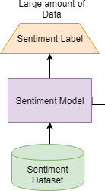
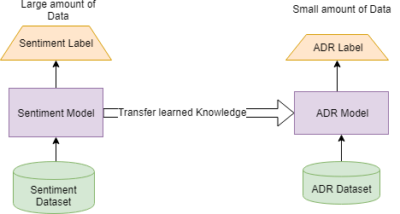
What?
“i really hate^{[SA]} the fact that i feel like i need to throw up^{[SA/ADR]} while at work. maybe taking my [drug] wasn't a good idea^{[SA]}”. (+)
Obj → take advantage of the similarity between the two tasks (i.e. SA and ADR).
3

Slide 4
Why SA and TL?
Leverage the similarity between the two tasks.
TL Enables us to use sentiment data while avoiding using any hand-crafted features.
Our approach has the advantage for working with relatively small data for the target domain.
Initialising the target model by the pretrained model helps to reduce training time in general.
4

Slide 5
Message
Intuition:
  Based on the observation that in social media, negative sentiment is frequently expressed towards ADRs.
Contribution:
  a neural network that combines sentiment analysis with transfer learning to improve ADR detection in social media postings.
  In contrast to previous research, we avoid the use of any hand-crafted features.
5

Slide 6
ADR datasets
  Show a couple of examples
Sentiment dataset
Preprocessing
Data
6
Notes:
: to identify posts reporting an adr from those that do not.
6

Slide 7
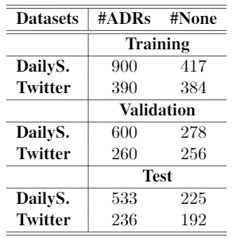


Datasets
Collected from two domains
  Twitter
  DailyStrength (DailyS.): is a specialised social networking website for health.
Original partition
  Training 75%
  Testing 25%
Nikfarjam, A., Sarker, A., O’connor, K., Ginn, R., & Gonzalez, G. (2015). Pharmacovigilance from social media: mining adverse drug reaction mentions using sequence labeling with word embedding cluster features. Journal of the American Medical Informatics Association, 22(3), 671-681.
7
Notes:
DailyStrength is a specialised social networking website for health.
7

Slide 8
Examples
: is it hot in here or is [drug] just kicking in?
: loved [drug], except for not being able to be woken up at night...
8
8
Notes:
DailyS example has keywords which are more health specific than Twitter.
8

Slide 9

Sentiment Analysis Corpus
SemEval17-task4A (Rosenthal et al., 2017):
  Collected from Twitter
  Partitioned into: Training (50k) and Test(12k
Preprocessing (Baziotis et al., 2017):
  A tool designed for social media
  A number of functionalities (e.g. )
9
Notes:
Since Twitter data possesses specific characteristics: including informal language, misspellings, and abbreviations.
we preprocess the data by using a tool, which is specifically designed for Twitter domain.
The tool provides a number of different functionalities like tokenization, normalization, and spelling-checking.
Show some info about sentiment distribution.
9

Slide 10
Transfer Learning Strategy
Model Architecture
Fine-tuning Methods
Methods (TL)
10

Slide 11
Transfer Learning Strategy
Same architecture
Sequential transfer learning
  pre-train a classifier on a corpus annotated with sentiment information
  then to adapt this pretrained to the target task (i.e. ADR)
SA dataset
Pretrained model
fine-tuning
ADR dataset
11
Notes:
Leverage Sentiment data using Transfer learning for ADR classification.
11

Slide 12
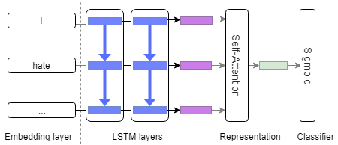
Model Architecture
12
Notes:
1. The model consists of word-embeddings by mapping words to their embeddings.
2. The output of this layer is passed to two lstm layers, where the output is concatenated and pass again to a self-attention mechinsum.
-The self-attention encodes the representation of the whole sequence.
Finally, this representation is fed to the classification layer where it outputs either + or – for the given example.
--------------------------------------------------------------------------------------------
The ADR model follows the same archs as the one used for sentiment except the classification layer.
12

Slide 13
Fine-tuning Methods
Last(a)
Full-except-Emb(d)
Chain-thaw(a,b,c,d)
Simple Gradual Unfreezing
  Similar to chain-thaw
  Conditioned on the number of epoch
Output
Output
Output
Output
LSTM
LSTM
LSTM
LSTM
Embed
Embed
Embed
Embed
a
b
c
d
13
Notes:
13

Slide 14
Results & Analysis
14

Slide 15
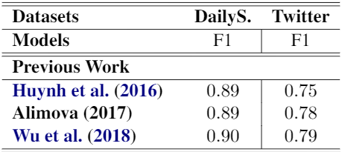

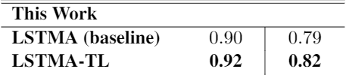
Results
Previous work
  Among the three models, the 3rd model achieved the best results.
  Used deep archs and hand-crafted features
Bert-base
  Obtained competitive results to our best model for Twitter, but not for DailyS.
  Training time requires huge amount of resources
For experiments related to this work
  Our LSTMA-TL achieved the best results
  Demonstrating the utility and advantages of transfer learning
  Our model can be easily trained on CPU
  Our model achieves high result on DailyS. Although it is pertained on Twitter data.
15
Notes:
For experiments related to previous work, we replicated the three models following their details as described in the papers:
- achieve competitive results. However, it is important to note that in contrast to our model architecture, that of Wu et al. (2018) is more complex and it relies on hand-crafted features as well as deep neural architectures.
We also experimented with BERT.
- which shows competitive results for Twitter dataset, but not for the dailyStrength.
For our own results, we report the results of three different experiments.
- Firstly, the baseline (LSTMA) is trained to detect ADRs using only the ADR datasets mentioned above, without the use of transfer learning.
- The other two models (LSTMA-TL and BiLSTMA-TL) apply transfer learning, making use of pre-training of a sentiment analysis model using the SemEval17-
task4A dataset. These latter two models different in terms of whether they use a single direction or bi-directional LSTM.
----------------------------------------------------------------------------------------------------
Alimova (2017) used an SVM model with different types of hand-crafted features (i.e. sentiment and corpus-based features).
Huynh et al. (2016) used a CNN model.
Compared our model to:
The three top performing systems for ADR classification
Bert-Base
This Work:
Baseline where no TL is applied.
The 2nd and 3rd models where we utilized SA model for fine-tuning ADR model.
15

Slide 16
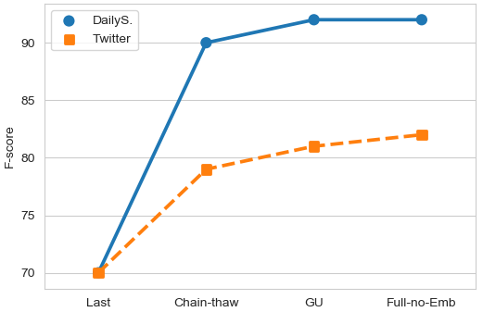
Impact of Fine-tuning
Take away
The choice of fine-tuning method makes a huge difference.
16
Notes:
“Last” achieved the lowest performance; this is not surprising, because it contains the least general knowledge.
In contrast, “Chain-thaw” achieved better results than “Last”. The “Full” and “GU” obtained the best results for ADR classification.
When we fine-tuned the whole network, we modified the “Full” method such that the embedding layer is frozen.
16

Slide 17
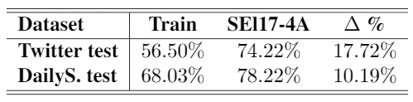
Word Coverage
Take away
The vocabularies used in the SA dataset and the ADR datasets share a large proportion of common words
Confirms our observation, where ADR model can benefit from the proliferation of sentiment data available.
17
Notes:
We observed that the vocabularies used in the sentiment analysis dataset and the ADR datasets share a large proportion of common words.
17

Slide 18
Conclusion
This work:
  Proposed a classification system for ADRs
  Our system outperforms previous models without using any hand-crafted features
  showed some analyses that demonstrate the effectiveness of our approach for the task of ADR.
Future work: Extract the text span of the reported
18
Notes:
In Summary, we demonstrate in this work how we improve classification of ADR system by combining SA + TL.
18

Slide 19

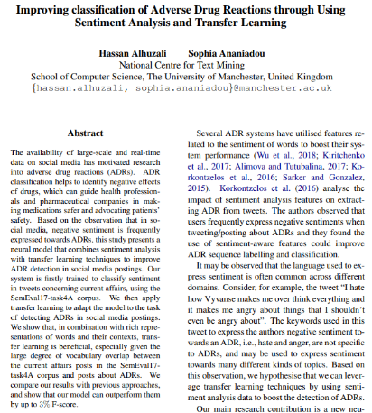
Thank You
https://hasanhuz.github.io/
https://www.aclweb.org/anthology/W19-5036/
19

Slide 20
Error Analysis: Examples
Correct prediction by LSTMA-TL
Incorrect prediction by LSTMA-TL
E(2): anyone ever taken [drug_name]? i’ve been on it for a week, not too sure how I feel about it yet. anyone want to share their experience?.
E(3): loved it, except for not being able to be woken up at night .. yeah that blew.
E(4): moved on to something else when it quit working.
E(5): i’m with you. even though the [drug_name] works, I still don’t feel fully human.
20

